Slide 1
E-LEARNING
TAINGUYEN-MEUMOC
MENTORSHIP_PROGRAM

Slide 2
AGENDA
I. OUTLINE
II. ANALYSIS

Slide 3

I. OUTLINE
1. USE CASE
2. DATABASE
3. UI/UX

Slide 4
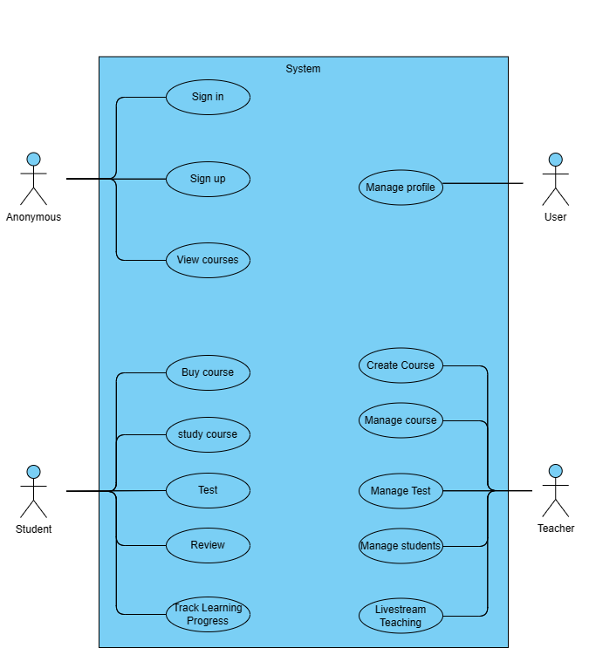

Slide 5
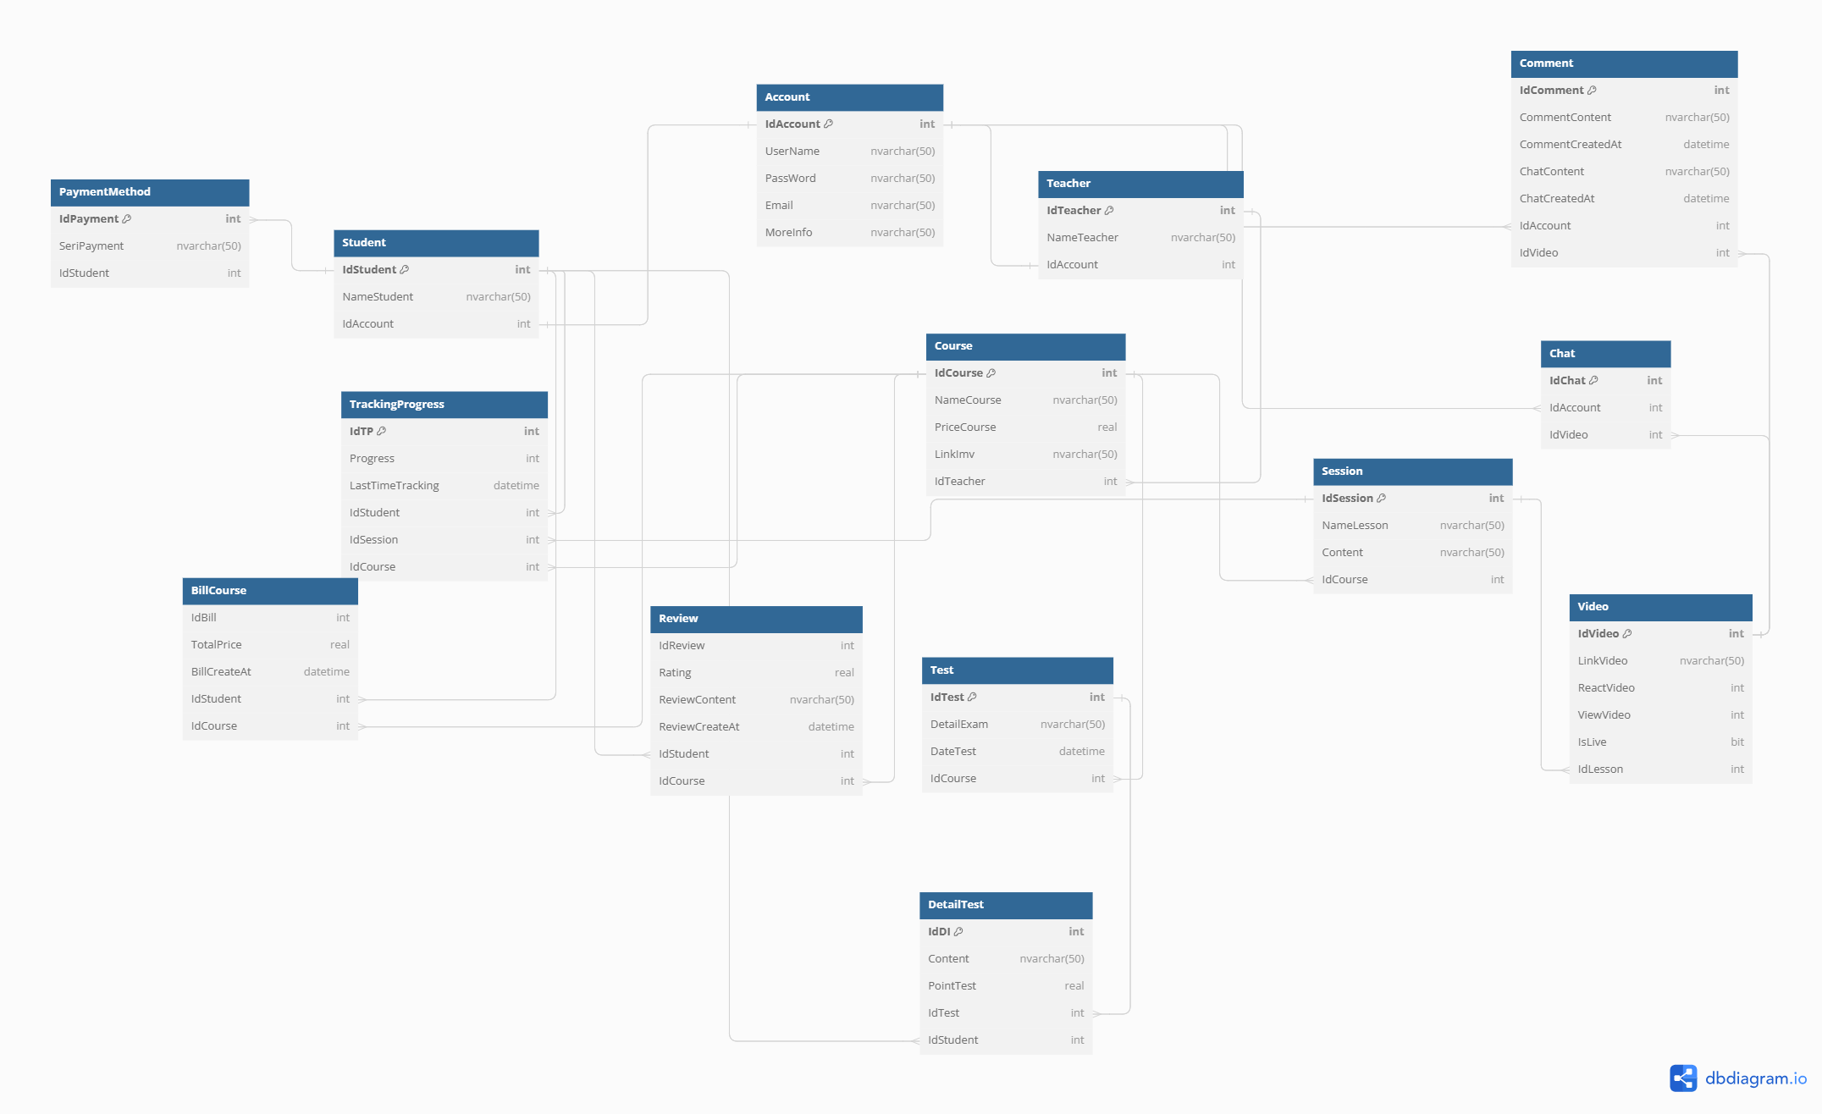

Slide 6


Slide 7
II. ANALYSIS
1. TEST DATA
2. SELECT DATA

Slide 8


1.TEST DATA

Slide 9
Insert into Account Values(1,'Duy','abc','duygmail','aaaaa')
Insert into Account Values(2,'Tai','ccc','taigmail','bbbb')
Insert into Account Values(3,'Ngoc','nnnn','ngocgmail','nnnn')
Insert into Teacher Values(1,'Duy',1)
Insert into Student Values(1,'Tai',2)
Insert into Student Values(2,'Ngoc',3)
Insert into Course Values(1,'UI',100000,'aaaaaa',1)
Insert into Course Values(2,'Design',99999,'bbbbb',1)
Insert into Session Values(1,'Lesson1','ThisIsLesson1',1)
Insert into Session Values(2,'Lesson2','ThisIsLesson2',1)
Insert into Session Values(3,'Lesson3','ThisIsLesson3',1)
Insert into Session Values(4,'Lesson4','ThisIsLesson4',1)
Insert into Session Values(5,'Des1','ThisIsDes1',2)

Slide 10
Insert into Review Values(1,4.5,'Good','2024-04-17 09:30:00',1,1)
Insert into Review Values(2,3.5,'Not Bad','2024-04-17 09:30:00',2,1)
Insert into Review Values(3,1.0,'Bad','2024-04-17 09:30:00',1,2)
Insert into TrackingProgress Values(1,1,'2024-04-17 09:30:00',1,1,1)
Insert into TrackingProgress Values(2,3,'2024-04-17 09:30:00',2,3,1)

Slide 11
2. SELECT DATA

Slide 12
II. ANALYSIS
1. NAME COURSE, TEACHER, AVG RATING
2. SESSION
3. TRACKING PROGRESS
4. REVIEW

Slide 13
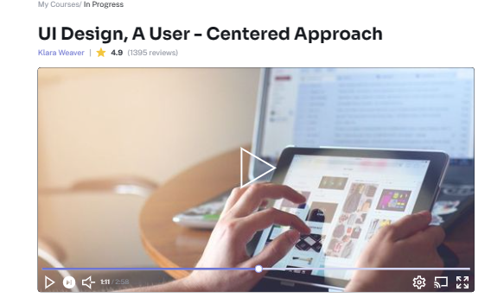
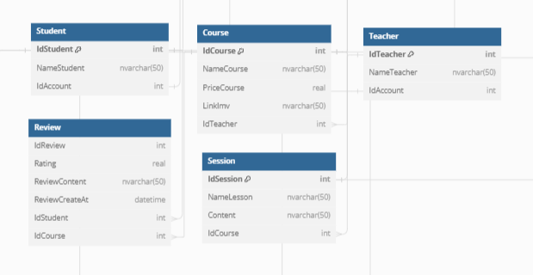
1. NAME COURSE, TEACHER, AVG RATING

Slide 14
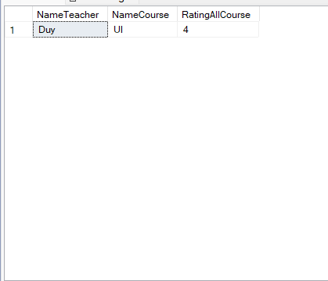
-- Select Name of Teacher, their name of course and rating of their course in Course's student with their choice IdCourse =1
Select t.NameTeacher,c.NameCourse,AVG(r.Rating) as 'RatingAllCourse'
From Teacher t
Join Course c on c.IdTeacher=t.IdTeacher
Join Review r on r.IdCourse = c.IdCourse
Join Student st on st.IdStudent = r.IdStudent
Join Session s on s.IdCourse = c.IdCourse
Where c.IdCourse=1
Group by t.NameTeacher, c.NameCourse

Slide 15
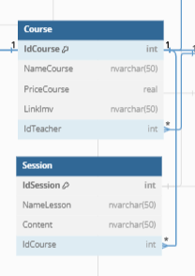
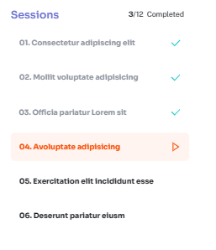
2. SESSION

Slide 16
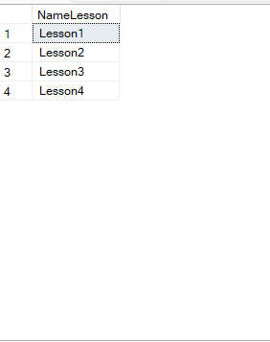
-- Select Name Lession with idCourse=1
Select s.NameLesson
From Course c
Join Session s on s.IdCourse = c.IdCourse
Where c.IdCourse=1
Group by s.NameLesson

Slide 17
3. TRACKING PROGRESS

Slide 18
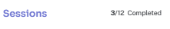
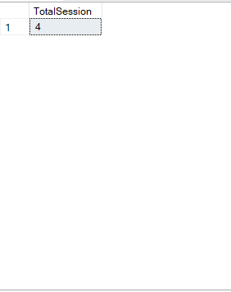
3.1 TOTAL SESSION
-- Select Total Session of course with IdCourse=1
Select count(s.NameLesson)as 'TotalSession'
From Teacher t
Join Course c on c.IdTeacher=t.IdTeacher
Join Session s on s.IdCourse = c.IdCourse
where c.IdCourse=1

Slide 19
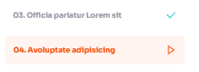
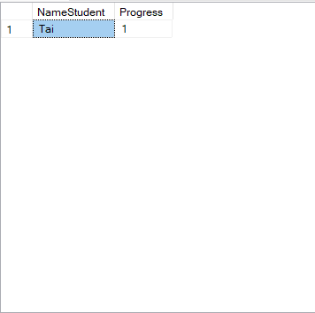
3.2 TRACK PROGRESS
-- Select Progress of student with idStudent = 1 and idCourse =1
Select st.NameStudent,tp.Progress
From Course c
Join Session s on s.IdCourse = c.IdCourse
Join TrackingProgress tp on tp.IdCourse=c.IdCourse
Join Student st on st.IdStudent = tp.IdStudent
Where st.IdStudent=1 and c.IdCourse=1
Group by st.NameStudent,tp.Progress

Slide 20
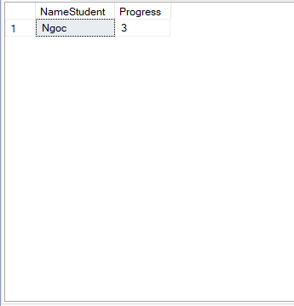
3.2 TRACK PROGRESS
-- Select Progress of student with idStudent = 2 and idCourse =1
Select st.NameStudent,tp.Progress
From Course c
Join Session s on s.IdCourse = c.IdCourse
Join TrackingProgress tp on tp.IdCourse=c.IdCourse
Join Student st on st.IdStudent = tp.IdStudent
Where st.IdStudent=2 and c.IdCourse=1
Group by st.NameStudent,tp.Progress

Slide 21
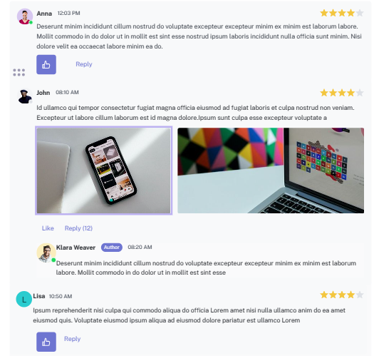
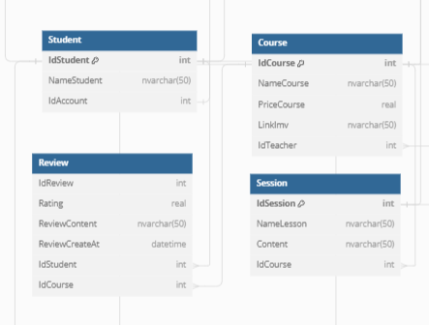
4. REVIEW

Slide 22
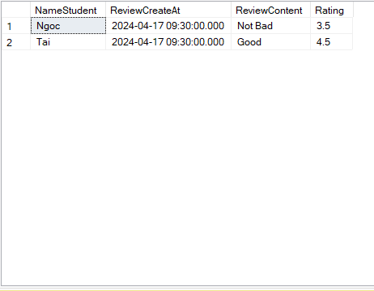
3. REVIEW
-- Select Review of Course with id=1
Select st.NameStudent,r.ReviewCreateAt,r.ReviewContent,r.Rating
From Course c
Join Session s on s.IdCourse = c.IdCourse
Join Review r on r.IdCourse = c.IdCourse
Join Student st on st.IdStudent = r.IdStudent
Where c.IdCourse=1
Group by st.NameStudent,r.ReviewCreateAt,r.ReviewContent,r.Rating

Slide 23
THANKS FOR READING

